Slide 1


Spatial density estimation with MNO-data: A modular workflow within
Marco Ramljak, uRos 2021 Lightning Talk
Email: marcoramljak@googlemail.com
First glimpse: https://r-ramljak.github.io/MNO_mobdensity/
MNOanalysis

Slide 2
Modular workflow for investigating spatial density within the static approach
Generation
Estimation
Evaluation
Operating area specification/generation (regular grid, ground truth population)
Model specification: Geolocation, priors, supertiles
Comparison of ground truth with all density estimates: (Dis-) similarity
Network specification/generation (R::mobloc, multiple network layers)
Deterministic model
Probabilistic model
KWD recommendation (R::SpatialKWD)
Phone-to-cell association (random process; emission probabilities)
Voronoi (with prior):
Tower
Offset
Barycenter
Simple bayes
MLE/EM
DF approx.
Other ...
Investigating convergence behaviour
Visual analysis tools
Cell counter
Spatial density maps
KWD values
Operating area with GTP
Generative model (emission prob.)
Spatial density estimate vectors
MSE/D2 density plots
Convergence assessment

Slide 3
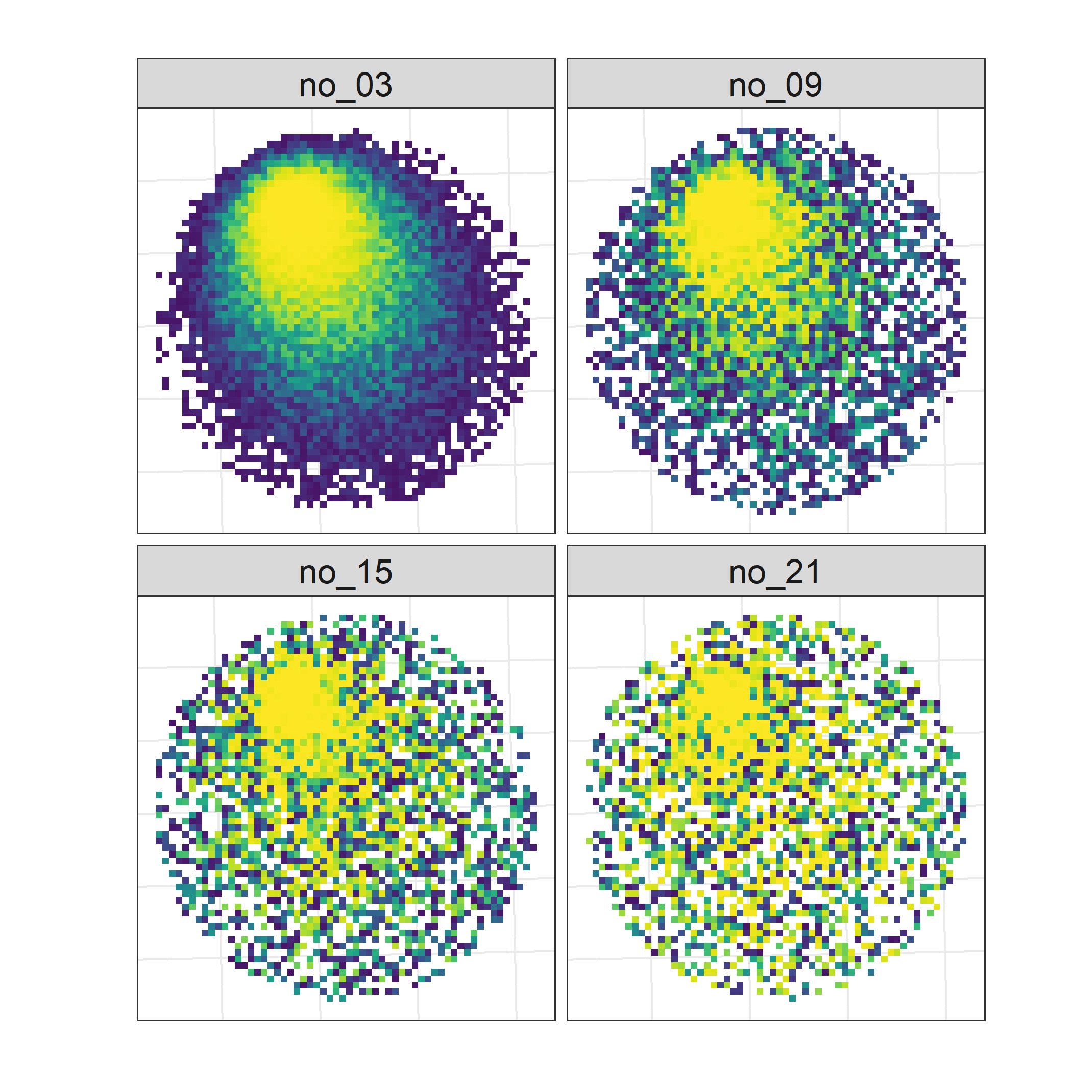
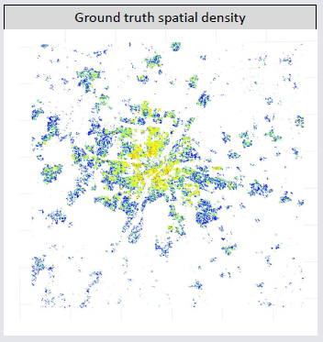
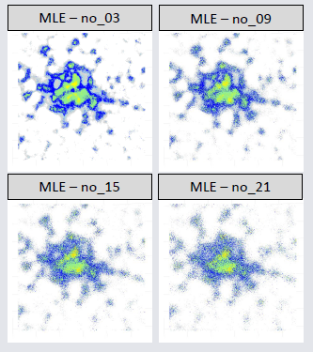
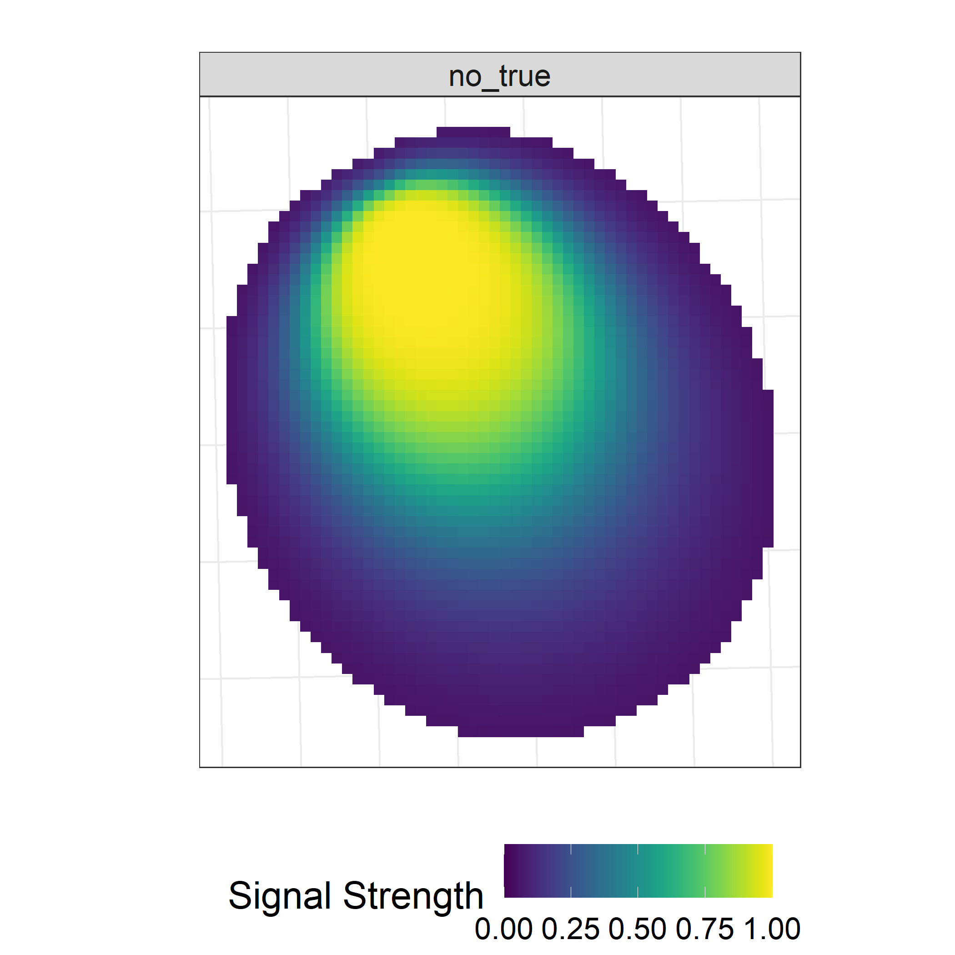
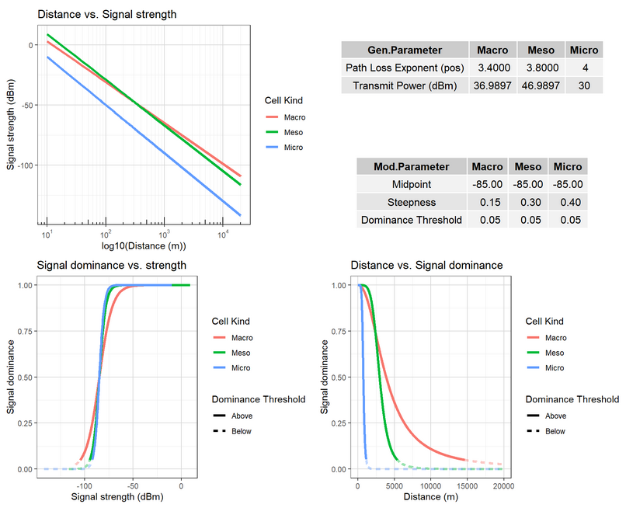
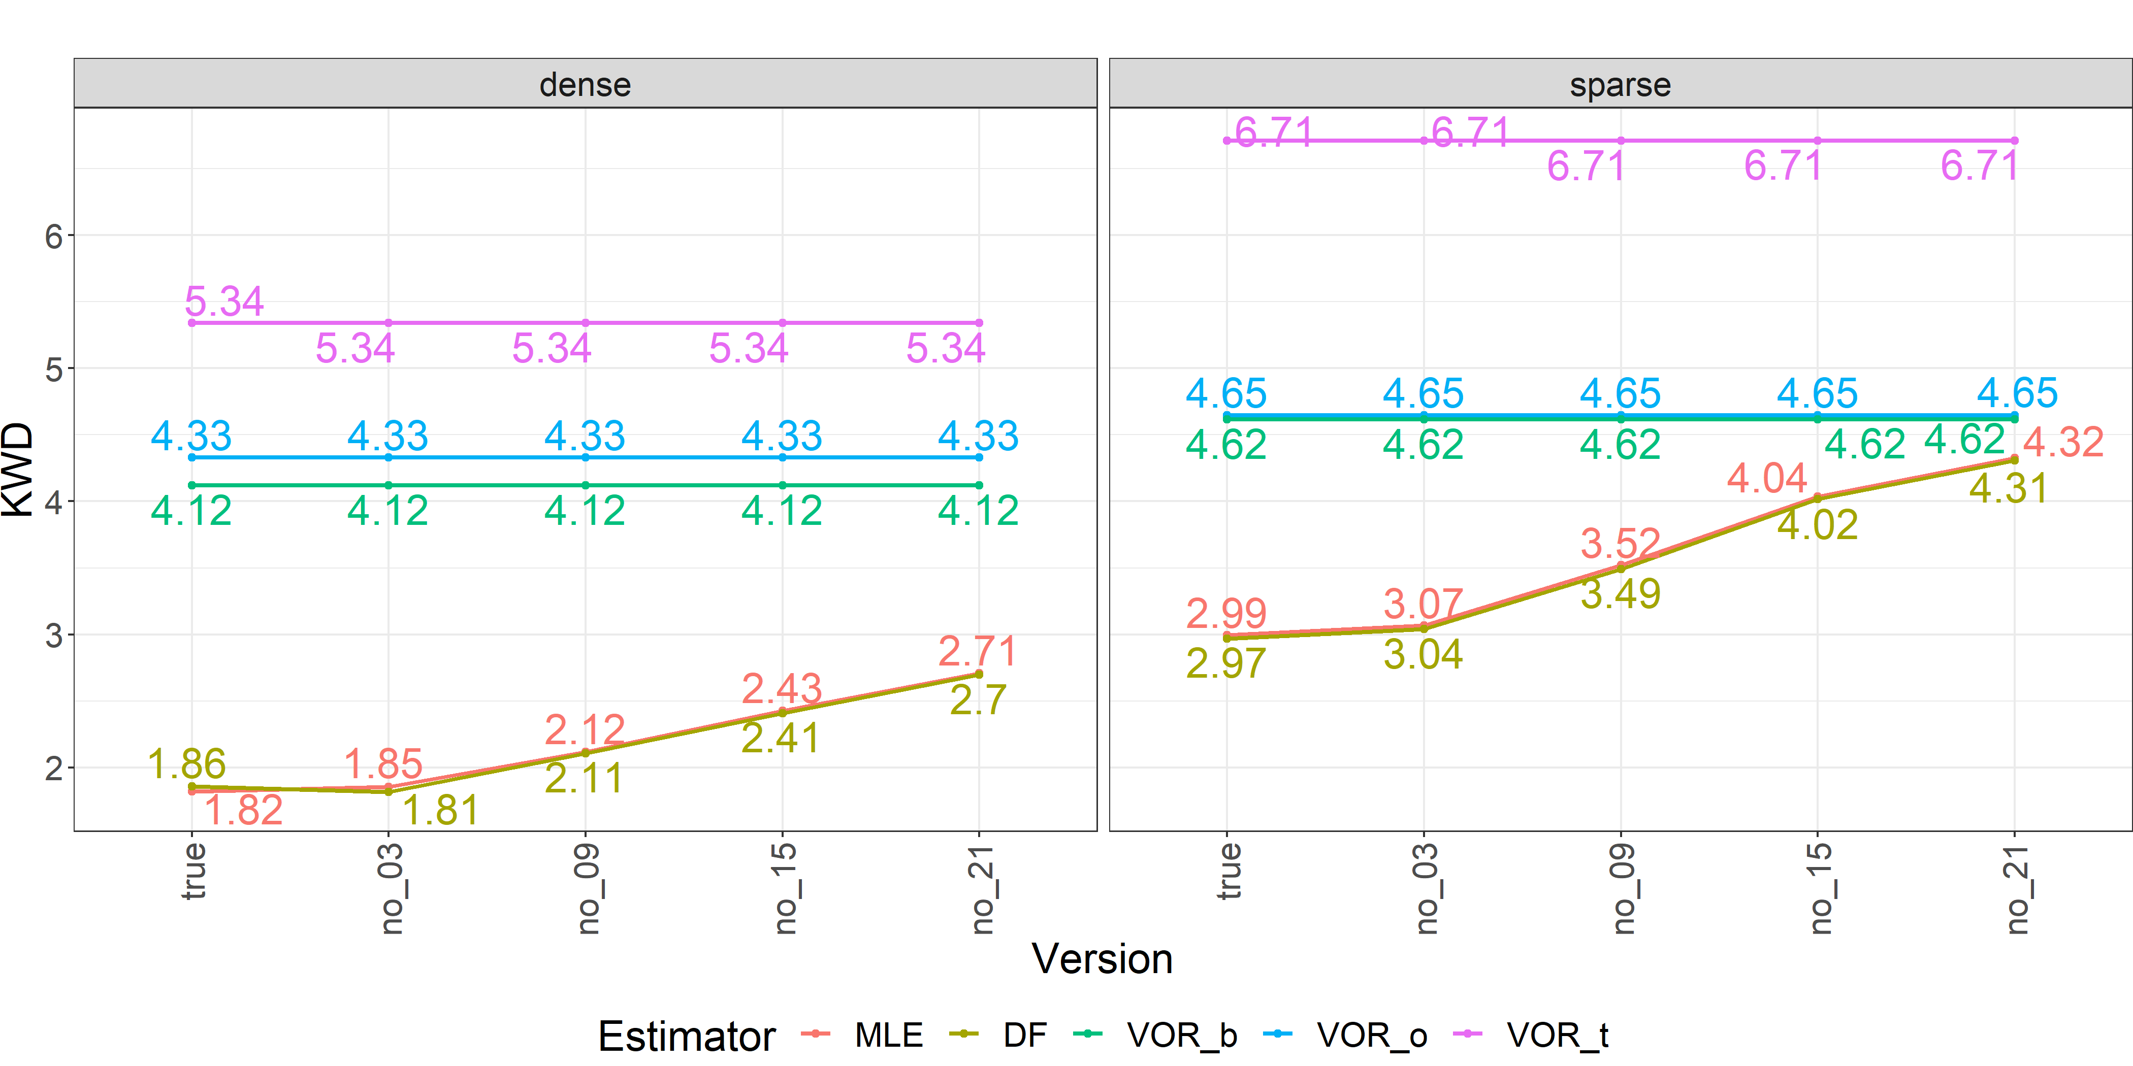
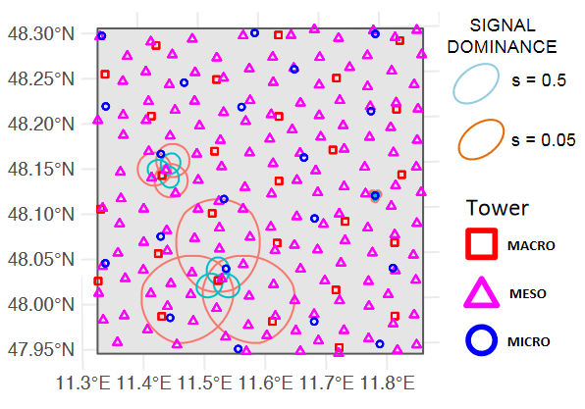
Example: Sensitivity analysis concerning model uncertainties
Generation
Estimation
Evaluation
Population generation
Purposefully implement model mismatch, e.g., random noise
Spatial density maps
#real census data
pop_gen(Germany)
?
Multi Layer Network generation (R::mobloc)
KWD analysis (R::SpatialKWD)
Estimators
EM_est(prior, iter = 1,…)
EM_est(iter = 200) #thx Mátyás
DF_est(…)
VOR_est(seed = c(tower, offset,
barycenter)

Slide 4
Main R-Packages and References
# Data manipulation
library(tidyverse)
library(data.table)
# Spatial operations
library(sf)
library(raster)
library(stars)
# Matrix operations
library(Matrix)
# MNO data handling and propagation model setup
# Credits to Prof. Martijn Tennekes https://github.com/mtennekes/mobloc
library(mobloc)
# Comparison of 2d histograms (Kantorovitch Wasserstein distance a.k.a. Earth Movers distance)
# Credits to Prof. Stefano Gualandi https://cran.r-project.org/web/packages/SpatialKWD/SpatialKWD.pdf
library(SpatialKWD)
Ricciato, F., & Coluccia, A. (2020). On the estimation of spatial density from mobile network operator data. arXiv preprint arXiv:2009.05410.
Tennekes, M., & Gootzen, Y. A. (2021). A Bayesian approach to location estimation of mobile devices from mobile network operator data. arXiv preprint arXiv:2110.00439.
Bassetti, F., Gualandi, S., & Veneroni, M. (2020). On the Computation of Kantorovich--Wasserstein Distances Between Two-Dimensional Histograms by Uncapacitated Minimum Cost Flows. SIAM Journal on Optimization, 30(3), 2441-2469.

